Slide 1

Transport Layer Part 3
Mark Allman
mallman@case.edu
EECS 325/425
Fall 2018
“Oh give me the beat boys, and free my soul, I wanna get lost in your rock ’n’ roll…”

Slide 2
These slides are more-or-less directly from the slide set developed by Jim Kurose and Keith Ross for their book “Computer Networking: A Top Down Approach, 5th edition”.
The slides have been lightly adapted for Mark Allman’s EECS 325/425 Computer Networks class at Case Western Reserve University.
All material copyright 1996-2010
J.F Kurose and K.W. Ross, All Rights Reserved
Allman
2

Slide 3
rdt2.0

Slide 4
rdt2.0
GOAL: reliable data delivery

Slide 5
rdt2.0
GOAL: reliable data delivery
Path between sender and receiver unreliable because it can corrupt packets

Slide 6
rdt2.0
GOAL: reliable data delivery
Path between sender and receiver unreliable because it can corrupt packets
Introduced three mechanisms to cope with this:

Slide 7
rdt2.0
GOAL: reliable data delivery
Path between sender and receiver unreliable because it can corrupt packets
Introduced three mechanisms to cope with this:
checksums
ACKs: positive acknowledgments
NAKs: negative acknowledgments

Slide 8
rdt2.0: FSM specification
rdt_send(data)
sndpkt = make_pkt(data, checksum) udt_send(sndpkt)
receiver
rdt_rcv(rcvpkt) && corrupt(rcvpkt)
Wait for call from above
Wait for ACK or NAK
rdt_rcv(rcvpkt) &&
isNAK(rcvpkt)
udt_send(sndpkt)
udt_send(NAK)
rdt_rcv(rcvpkt) && isACK(rcvpkt)
Wait for call from below
Λ
sender
rdt_rcv(rcvpkt) && notcorrupt(rcvpkt)
extract(rcvpkt,data) deliver_data(data) udt_send(ACK)

Slide 9
rdt2.0 has a fatal flaw!

Slide 10
rdt2.0 has a fatal flaw!
What happens if ACK/ NAK corrupted?

Slide 11
rdt2.0 has a fatal flaw!
What happens if ACK/ NAK corrupted?
sender doesn’t know what happened at receiver!
can’t just retransmit: possible duplicate

Slide 12
rdt2.0 has a fatal flaw!
What happens if ACK/ NAK corrupted?
sender doesn’t know what happened at receiver!
can’t just retransmit: possible duplicate
Handling duplicates:
sender retransmits current pkt if ACK/NAK garbled
sender adds sequence number to each pkt
receiver discards (doesn’t deliver up) duplicate pkt

Slide 13
rdt2.1: sender, handles garbled ACK/NAKs

Slide 14
rdt2.1: sender, handles garbled ACK/NAKs
Wait for call 0 from above

Slide 15
rdt2.1: sender, handles garbled ACK/NAKs
rdt_send(data)
sndpkt = make_pkt(0, data, checksum) udt_send(sndpkt)
Wait for call 0 from above

Slide 16
rdt2.1: sender, handles garbled ACK/NAKs
rdt_send(data)
sndpkt = make_pkt(0, data, checksum) udt_send(sndpkt)
Wait for call 0 from above
Wait for ACK or NAK 0

Slide 17
rdt2.1: sender, handles garbled ACK/NAKs
rdt_send(data)
sndpkt = make_pkt(0, data, checksum) udt_send(sndpkt)
Wait for call 0 from above
Wait for ACK or NAK 0
rdt_rcv(rcvpkt)
&& notcorrupt(rcvpkt) && isACK(rcvpkt)
Λ

Slide 18
rdt2.1: sender, handles garbled ACK/NAKs
rdt_send(data)
sndpkt = make_pkt(0, data, checksum) udt_send(sndpkt)
Wait for call 0 from above
Wait for ACK or NAK 0
rdt_rcv(rcvpkt)
&& notcorrupt(rcvpkt) && isACK(rcvpkt)
Λ
Wait for call 1 from above

Slide 19
rdt2.1: sender, handles garbled ACK/NAKs
rdt_send(data)
sndpkt = make_pkt(0, data, checksum) udt_send(sndpkt)
Wait for call 0 from above
Wait for ACK or NAK 0
rdt_rcv(rcvpkt)
&& notcorrupt(rcvpkt) && isACK(rcvpkt)
Λ
Wait for call 1 from above
rdt_send(data)
sndpkt = make_pkt(1, data, checksum) udt_send(sndpkt)

Slide 20
rdt2.1: sender, handles garbled ACK/NAKs
rdt_send(data)
sndpkt = make_pkt(0, data, checksum) udt_send(sndpkt)
Wait for call 0 from above
Wait for ACK or NAK 0
rdt_rcv(rcvpkt)
&& notcorrupt(rcvpkt) && isACK(rcvpkt)
Λ
Wait for call 1 from above
rdt_send(data)
sndpkt = make_pkt(1, data, checksum) udt_send(sndpkt)

Slide 21
rdt2.1: sender, handles garbled ACK/NAKs
rdt_send(data)
sndpkt = make_pkt(0, data, checksum) udt_send(sndpkt)
Wait for call 0 from above
Wait for ACK or NAK 0
rdt_rcv(rcvpkt)
&& notcorrupt(rcvpkt) && isACK(rcvpkt)
Λ
Wait for call 1 from above
rdt_send(data)
sndpkt = make_pkt(1, data, checksum) udt_send(sndpkt)

Slide 22
rdt2.1: sender, handles garbled ACK/NAKs
rdt_send(data)
sndpkt = make_pkt(0, data, checksum) udt_send(sndpkt)
Wait for call 0 from above
Wait for ACK or NAK 0
rdt_rcv(rcvpkt)
&& notcorrupt(rcvpkt) && isACK(rcvpkt)
Λ
Wait for ACK or NAK 1
Wait for call 1 from above
rdt_send(data)
sndpkt = make_pkt(1, data, checksum) udt_send(sndpkt)

Slide 23
rdt2.1: sender, handles garbled ACK/NAKs
rdt_send(data)
sndpkt = make_pkt(0, data, checksum) udt_send(sndpkt)
Wait for call 0 from above
Wait for ACK or NAK 0
rdt_rcv(rcvpkt)
&& notcorrupt(rcvpkt) && isACK(rcvpkt)
rdt_rcv(rcvpkt)
&& notcorrupt(rcvpkt) && isACK(rcvpkt)
Λ
Λ
Wait for ACK or NAK 1
Wait for call 1 from above
rdt_send(data)
sndpkt = make_pkt(1, data, checksum) udt_send(sndpkt)

Slide 24
rdt2.1: sender, handles garbled ACK/NAKs
rdt_send(data)
sndpkt = make_pkt(0, data, checksum) udt_send(sndpkt)
Wait for call 0 from above
Wait for ACK or NAK 0
rdt_rcv(rcvpkt)
&& notcorrupt(rcvpkt) && isACK(rcvpkt)
rdt_rcv(rcvpkt)
&& notcorrupt(rcvpkt) && isACK(rcvpkt)
Λ
Λ
Wait for ACK or NAK 1
Wait for call 1 from above
rdt_send(data)
sndpkt = make_pkt(1, data, checksum) udt_send(sndpkt)

Slide 25
rdt2.1: sender, handles garbled ACK/NAKs
rdt_send(data)
sndpkt = make_pkt(0, data, checksum) udt_send(sndpkt)
Wait for call 0 from above
Wait for ACK or NAK 0
rdt_rcv(rcvpkt)
&& notcorrupt(rcvpkt) && isACK(rcvpkt)
rdt_rcv(rcvpkt)
&& notcorrupt(rcvpkt) && isACK(rcvpkt)
Λ
Λ
Wait for ACK or NAK 1
Wait for call 1 from above
rdt_send(data)
sndpkt = make_pkt(1, data, checksum) udt_send(sndpkt)

Slide 26
rdt2.1: sender, handles garbled ACK/NAKs
rdt_send(data)
sndpkt = make_pkt(0, data, checksum)
udt_send(sndpkt)
rdt_rcv(rcvpkt) && ( corrupt(rcvpkt) || isNAK(rcvpkt) )
Wait for call 0 from above
Wait for ACK or NAK 0
udt_send(sndpkt)
rdt_rcv(rcvpkt)
&& notcorrupt(rcvpkt) && isACK(rcvpkt)
rdt_rcv(rcvpkt)
&& notcorrupt(rcvpkt) && isACK(rcvpkt)
Λ
Λ
Wait for ACK or NAK 1
Wait for call 1 from above
rdt_send(data)
sndpkt = make_pkt(1, data, checksum) udt_send(sndpkt)

Slide 27
rdt2.1: sender, handles garbled ACK/NAKs
rdt_send(data)
sndpkt = make_pkt(0, data, checksum)
udt_send(sndpkt)
rdt_rcv(rcvpkt) && ( corrupt(rcvpkt) || isNAK(rcvpkt) )
Wait for call 0 from above
Wait for ACK or NAK 0
udt_send(sndpkt)
rdt_rcv(rcvpkt)
&& notcorrupt(rcvpkt) && isACK(rcvpkt)
rdt_rcv(rcvpkt)
&& notcorrupt(rcvpkt) && isACK(rcvpkt)
Λ
Λ
Wait for ACK or NAK 1
Wait for call 1 from above
rdt_send(data)
sndpkt = make_pkt(1, data, checksum) udt_send(sndpkt)

Slide 28
rdt2.1: sender, handles garbled ACK/NAKs
rdt_send(data)
sndpkt = make_pkt(0, data, checksum)
udt_send(sndpkt)
rdt_rcv(rcvpkt) && ( corrupt(rcvpkt) || isNAK(rcvpkt) )
Wait for call 0 from above
Wait for ACK or NAK 0
udt_send(sndpkt)
rdt_rcv(rcvpkt)
&& notcorrupt(rcvpkt) && isACK(rcvpkt)
rdt_rcv(rcvpkt)
&& notcorrupt(rcvpkt) && isACK(rcvpkt)
Λ
Λ
Wait for ACK or NAK 1
Wait for call 1 from above
rdt_rcv(rcvpkt) && ( corrupt(rcvpkt) || isNAK(rcvpkt) )
rdt_send(data)
udt_send(sndpkt)
sndpkt = make_pkt(1, data, checksum) udt_send(sndpkt)

Slide 29
rdt2.1: sender, handles garbled ACK/NAKs
rdt_send(data)
sndpkt = make_pkt(0, data, checksum)
udt_send(sndpkt)
rdt_rcv(rcvpkt) && ( corrupt(rcvpkt) || isNAK(rcvpkt) )
Wait for call 0 from above
Wait for ACK or NAK 0
udt_send(sndpkt)
rdt_rcv(rcvpkt)
&& notcorrupt(rcvpkt) && isACK(rcvpkt)
rdt_rcv(rcvpkt)
&& notcorrupt(rcvpkt) && isACK(rcvpkt)
Λ
Λ
Wait for ACK or NAK 1
Wait for call 1 from above
rdt_rcv(rcvpkt) && ( corrupt(rcvpkt) || isNAK(rcvpkt) )
rdt_send(data)
udt_send(sndpkt)
sndpkt = make_pkt(1, data, checksum) udt_send(sndpkt)

Slide 30
rdt2.1: sender, handles garbled ACK/NAKs
rdt_send(data)
sndpkt = make_pkt(0, data, checksum)
udt_send(sndpkt)
rdt_rcv(rcvpkt) && ( corrupt(rcvpkt) || isNAK(rcvpkt) )
Wait for call 0 from above
Wait for ACK or NAK 0
udt_send(sndpkt)
rdt_rcv(rcvpkt)
&& notcorrupt(rcvpkt) && isACK(rcvpkt)
rdt_rcv(rcvpkt)
&& notcorrupt(rcvpkt) && isACK(rcvpkt)
Λ
Λ
Wait for ACK or NAK 1
Wait for call 1 from above
rdt_rcv(rcvpkt) && ( corrupt(rcvpkt) || isNAK(rcvpkt) )
rdt_send(data)
udt_send(sndpkt)
sndpkt = make_pkt(1, data, checksum) udt_send(sndpkt)

Slide 31
rdt2.1: receiver, handles garbled ACK/NAKs

Slide 32
rdt2.1: receiver, handles garbled ACK/NAKs
Wait for 0 from below

Slide 33
rdt2.1: receiver, handles garbled ACK/NAKs
rdt_rcv(rcvpkt) && notcorrupt(rcvpkt) && has_seq0(rcvpkt)
extract(rcvpkt,data) deliver_data(data)
sndpkt = make_pkt(ACK, chksum) udt_send(sndpkt)
Wait for 0 from below

Slide 34
rdt2.1: receiver, handles garbled ACK/NAKs
rdt_rcv(rcvpkt) && notcorrupt(rcvpkt) && has_seq0(rcvpkt)
extract(rcvpkt,data) deliver_data(data)
sndpkt = make_pkt(ACK, chksum) udt_send(sndpkt)
Wait for 0 from below
Wait for 1 from below

Slide 35
rdt2.1: receiver, handles garbled ACK/NAKs
rdt_rcv(rcvpkt) && notcorrupt(rcvpkt) && has_seq0(rcvpkt)
extract(rcvpkt,data) deliver_data(data)
sndpkt = make_pkt(ACK, chksum) udt_send(sndpkt)
Wait for 0 from below
Wait for 1 from below
rdt_rcv(rcvpkt) && notcorrupt(rcvpkt) && has_seq1(rcvpkt)
extract(rcvpkt,data) deliver_data(data)
sndpkt = make_pkt(ACK, chksum) udt_send(sndpkt)

Slide 36
rdt2.1: receiver, handles garbled ACK/NAKs
rdt_rcv(rcvpkt) && notcorrupt(rcvpkt) && has_seq0(rcvpkt)
extract(rcvpkt,data) deliver_data(data)
sndpkt = make_pkt(ACK, chksum) udt_send(sndpkt)
rdt_rcv(rcvpkt) && (corrupt(rcvpkt)
sndpkt = make_pkt(NAK, chksum) udt_send(sndpkt)
Wait for 0 from below
Wait for 1 from below
rdt_rcv(rcvpkt) && notcorrupt(rcvpkt) && has_seq1(rcvpkt)
extract(rcvpkt,data) deliver_data(data)
sndpkt = make_pkt(ACK, chksum) udt_send(sndpkt)

Slide 37
rdt2.1: receiver, handles garbled ACK/NAKs
rdt_rcv(rcvpkt) && notcorrupt(rcvpkt) && has_seq0(rcvpkt)
extract(rcvpkt,data) deliver_data(data)
sndpkt = make_pkt(ACK, chksum) udt_send(sndpkt)
rdt_rcv(rcvpkt) && (corrupt(rcvpkt)
sndpkt = make_pkt(NAK, chksum) udt_send(sndpkt)
Wait for 0 from below
Wait for 1 from below
rdt_rcv(rcvpkt) && notcorrupt(rcvpkt) && has_seq1(rcvpkt)
extract(rcvpkt,data) deliver_data(data)
sndpkt = make_pkt(ACK, chksum) udt_send(sndpkt)

Slide 38
rdt2.1: receiver, handles garbled ACK/NAKs
rdt_rcv(rcvpkt) && notcorrupt(rcvpkt) && has_seq0(rcvpkt)
extract(rcvpkt,data) deliver_data(data)
sndpkt = make_pkt(ACK, chksum) udt_send(sndpkt)
rdt_rcv(rcvpkt) && (corrupt(rcvpkt)
rdt_rcv(rcvpkt) && (corrupt(rcvpkt)
sndpkt = make_pkt(NAK, chksum) udt_send(sndpkt)
sndpkt = make_pkt(NAK, chksum) udt_send(sndpkt)
Wait for 0 from below
Wait for 1 from below
rdt_rcv(rcvpkt) && notcorrupt(rcvpkt) && has_seq1(rcvpkt)
extract(rcvpkt,data) deliver_data(data)
sndpkt = make_pkt(ACK, chksum) udt_send(sndpkt)

Slide 39
rdt2.1: receiver, handles garbled ACK/NAKs
rdt_rcv(rcvpkt) && notcorrupt(rcvpkt) && has_seq0(rcvpkt)
extract(rcvpkt,data) deliver_data(data)
sndpkt = make_pkt(ACK, chksum) udt_send(sndpkt)
rdt_rcv(rcvpkt) && (corrupt(rcvpkt)
rdt_rcv(rcvpkt) && (corrupt(rcvpkt)
sndpkt = make_pkt(NAK, chksum) udt_send(sndpkt)
sndpkt = make_pkt(NAK, chksum) udt_send(sndpkt)
Wait for 0 from below
Wait for 1 from below
rdt_rcv(rcvpkt) &&
not corrupt(rcvpkt) && has_seq0(rcvpkt)
sndpkt = make_pkt(ACK, chksum) udt_send(sndpkt)
rdt_rcv(rcvpkt) && notcorrupt(rcvpkt) && has_seq1(rcvpkt)
extract(rcvpkt,data) deliver_data(data)
sndpkt = make_pkt(ACK, chksum) udt_send(sndpkt)

Slide 40
rdt2.1: receiver, handles garbled ACK/NAKs
rdt_rcv(rcvpkt) && notcorrupt(rcvpkt) && has_seq0(rcvpkt)
extract(rcvpkt,data) deliver_data(data)
sndpkt = make_pkt(ACK, chksum) udt_send(sndpkt)
rdt_rcv(rcvpkt) && (corrupt(rcvpkt)
rdt_rcv(rcvpkt) && (corrupt(rcvpkt)
sndpkt = make_pkt(NAK, chksum) udt_send(sndpkt)
sndpkt = make_pkt(NAK, chksum) udt_send(sndpkt)
Wait for 0 from below
Wait for 1 from below
rdt_rcv(rcvpkt) &&
not corrupt(rcvpkt) && has_seq0(rcvpkt)
sndpkt = make_pkt(ACK, chksum) udt_send(sndpkt)
rdt_rcv(rcvpkt) && notcorrupt(rcvpkt) && has_seq1(rcvpkt)
extract(rcvpkt,data) deliver_data(data)
sndpkt = make_pkt(ACK, chksum) udt_send(sndpkt)

Slide 41
rdt2.1: receiver, handles garbled ACK/NAKs
rdt_rcv(rcvpkt) && notcorrupt(rcvpkt) && has_seq0(rcvpkt)
extract(rcvpkt,data) deliver_data(data)
sndpkt = make_pkt(ACK, chksum) udt_send(sndpkt)
rdt_rcv(rcvpkt) && (corrupt(rcvpkt)
rdt_rcv(rcvpkt) && (corrupt(rcvpkt)
sndpkt = make_pkt(NAK, chksum) udt_send(sndpkt)
sndpkt = make_pkt(NAK, chksum) udt_send(sndpkt)
Wait for 0 from below
Wait for 1 from below
rdt_rcv(rcvpkt) &&
not corrupt(rcvpkt) && has_seq1(rcvpkt)
rdt_rcv(rcvpkt) &&
not corrupt(rcvpkt) && has_seq0(rcvpkt)
sndpkt = make_pkt(ACK, chksum) udt_send(sndpkt)
sndpkt = make_pkt(ACK, chksum) udt_send(sndpkt)
rdt_rcv(rcvpkt) && notcorrupt(rcvpkt) && has_seq1(rcvpkt)
extract(rcvpkt,data) deliver_data(data)
sndpkt = make_pkt(ACK, chksum) udt_send(sndpkt)

Slide 42
rdt2.1: discussion
Sender:
seq # added to pkt
two seq. #’s (0,1) will suffice. Why?
must check if received ACK/NAK corrupted
twice as many states
 state must “remember” whether “current” pkt has 0 or 1 seq. #

Slide 43
rdt2.1: discussion
Sender:
seq # added to pkt
two seq. #’s (0,1) will suffice. Why?
must check if received ACK/NAK corrupted
twice as many states
 state must “remember” whether “current” pkt has 0 or 1 seq. #
Receiver:
must check if received packet is duplicate
 state indicates whether 0 or 1 is expected pkt seq #
note: receiver can not know if its last ACK/ NAK received OK at sender

Slide 44
rdt2.2: a NAK-free protocol
same functionality as rdt2.1, using ACKs only
instead of NAK, receiver sends ACK for last pkt received OK
 receiver must explicitly include seq # of pkt being ACKed
duplicate ACK at sender results in same action as NAK: retransmit current pkt

Slide 45
rdt2.2: sender, receiver fragments

Slide 46
rdt2.2: sender, receiver fragments
rdt_rcv(rcvpkt) && (corrupt(rcvpkt) || has_seq1(rcvpkt))
Λ
Wait for 0 from below
receiver FSM
udt_send(sndpkt)
fragment
rdt_rcv(rcvpkt) && notcorrupt(rcvpkt) && has_seq1(rcvpkt)
extract(rcvpkt,data) deliver_data(data)
sndpkt = make_pkt(ACK1, chksum)
udt_send(sndpkt)
Transport Layer
3-

Slide 47
rdt2.2: sender, receiver fragments
rdt_send(data)
sndpkt = make_pkt(0, data, checksum)
udt_send(sndpkt)
rdt_rcv(rcvpkt) && ( corrupt(rcvpkt) ||
isACK(rcvpkt,1) )
Wait for call 0 from above
Wait for ACK
0
udt_send(sndpkt)
sender FSM fragment
rdt_rcv(rcvpkt)
&& notcorrupt(rcvpkt) && isACK(rcvpkt,0)
rdt_rcv(rcvpkt) && (corrupt(rcvpkt) || has_seq1(rcvpkt))
Λ
Wait for 0 from below
receiver FSM
udt_send(sndpkt)
fragment
rdt_rcv(rcvpkt) && notcorrupt(rcvpkt) && has_seq1(rcvpkt)
extract(rcvpkt,data) deliver_data(data)
sndpkt = make_pkt(ACK1, chksum)
udt_send(sndpkt)
Transport Layer
3-

Slide 48
rdt3.0: channels with errors and loss
New context: underlying channel can also lose packets (data or ACKs)
 checksum, seq. #, ACKs, retransmissions will be of help, but not enough

Slide 49
rdt3.0: channels with errors and loss
New context: underlying channel can also lose packets (data or ACKs)
 checksum, seq. #, ACKs, retransmissions will be of help, but not enough
Approach: sender waits “reasonable” amount of time for ACK
retransmits if no ACK received in this time
if pkt (or ACK) just delayed (not lost):
retransmission will be duplicate, but use of seq. #’s already handles this
receiver must specify seq # of pkt being ACKed
requires countdown timer

Slide 50
rdt3.0 sender
Wait for call 0from above
Wait for ACK0
Wait for ACK1
Wait for call 1 from above

Slide 51
rdt3.0 sender
rdt_send(data)
sndpkt = make_pkt(0, data, checksum) udt_send(sndpkt)
start_timer
Wait for call 0from above
Wait for ACK0
Wait for ACK1
Wait for call 1 from above

Slide 52
rdt3.0 sender
rdt_send(data)
sndpkt = make_pkt(0, data, checksum) udt_send(sndpkt)
start_timer
Wait for call 0from above
Wait for ACK0
rdt_rcv(rcvpkt)
&& notcorrupt(rcvpkt) && isACK(rcvpkt,0)
stop_timer
Wait for ACK1
Wait for call 1 from above

Slide 53
rdt3.0 sender
rdt_send(data)
sndpkt = make_pkt(0, data, checksum) udt_send(sndpkt)
start_timer
Wait for call 0from above
Wait for ACK0
rdt_rcv(rcvpkt)
&& notcorrupt(rcvpkt) && isACK(rcvpkt,0)
stop_timer
Wait for ACK1
Wait for call 1 from above
rdt_send(data)
sndpkt = make_pkt(1, data, checksum) udt_send(sndpkt)
start_timer

Slide 54
rdt3.0 sender
rdt_send(data)
sndpkt = make_pkt(0, data, checksum) udt_send(sndpkt)
start_timer
Wait for call 0from above
Wait for ACK0
rdt_rcv(rcvpkt)
&& notcorrupt(rcvpkt) && isACK(rcvpkt,1)
rdt_rcv(rcvpkt)
&& notcorrupt(rcvpkt) && isACK(rcvpkt,0)
stop_timer
stop_timer
Wait for ACK1
Wait for call 1 from above
rdt_send(data)
sndpkt = make_pkt(1, data, checksum) udt_send(sndpkt)
start_timer

Slide 55
rdt3.0 sender
rdt_send(data)
sndpkt = make_pkt(0, data, checksum) udt_send(sndpkt)
start_timer
rdt_rcv(rcvpkt)
Λ
Wait for call 0from above
Wait for ACK0
rdt_rcv(rcvpkt)
&& notcorrupt(rcvpkt) && isACK(rcvpkt,1)
rdt_rcv(rcvpkt)
&& notcorrupt(rcvpkt) && isACK(rcvpkt,0)
stop_timer
stop_timer
Wait for ACK1
Wait for call 1 from above
rdt_rcv(rcvpkt)
rdt_send(data)
Λ
sndpkt = make_pkt(1, data, checksum) udt_send(sndpkt)
start_timer

Slide 56
rdt3.0 sender
rdt_send(data)
rdt_rcv(rcvpkt) && ( corrupt(rcvpkt) || isACK(rcvpkt,1) )
Λ
sndpkt = make_pkt(0, data, checksum) udt_send(sndpkt)
start_timer
rdt_rcv(rcvpkt)
Λ
Wait for call 0from above
Wait for ACK0
rdt_rcv(rcvpkt)
&& notcorrupt(rcvpkt) && isACK(rcvpkt,1)
rdt_rcv(rcvpkt)
&& notcorrupt(rcvpkt) && isACK(rcvpkt,0)
stop_timer
stop_timer
Wait for ACK1
Wait for call 1 from above
rdt_rcv(rcvpkt)
rdt_send(data)
Λ
sndpkt = make_pkt(1, data, checksum) udt_send(sndpkt)
start_timer

Slide 57
rdt3.0 sender
rdt_send(data)
rdt_rcv(rcvpkt) && ( corrupt(rcvpkt) || isACK(rcvpkt,1) )
Λ
sndpkt = make_pkt(0, data, checksum) udt_send(sndpkt)
start_timer
rdt_rcv(rcvpkt)
Λ
Wait for call 0from above
Wait for ACK0
timeout
udt_send(sndpkt) start_timer
rdt_rcv(rcvpkt)
&& notcorrupt(rcvpkt) && isACK(rcvpkt,1)
rdt_rcv(rcvpkt)
&& notcorrupt(rcvpkt) && isACK(rcvpkt,0)
stop_timer
stop_timer
Wait for ACK1
Wait for call 1 from above
rdt_rcv(rcvpkt)
rdt_send(data)
Λ
sndpkt = make_pkt(1, data, checksum) udt_send(sndpkt)
start_timer

Slide 58
rdt3.0 sender
rdt_send(data)
rdt_rcv(rcvpkt) && ( corrupt(rcvpkt) || isACK(rcvpkt,1) )
Λ
sndpkt = make_pkt(0, data, checksum) udt_send(sndpkt)
start_timer
rdt_rcv(rcvpkt)
Λ
Wait for call 0from above
Wait for ACK0
timeout
udt_send(sndpkt) start_timer
rdt_rcv(rcvpkt)
&& notcorrupt(rcvpkt) && isACK(rcvpkt,1)
rdt_rcv(rcvpkt)
&& notcorrupt(rcvpkt) && isACK(rcvpkt,0)
stop_timer
stop_timer
Wait for ACK1
Wait for call 1 from above
rdt_rcv(rcvpkt)
rdt_send(data)
Λ
rdt_rcv(rcvpkt) && ( corrupt(rcvpkt) || isACK(rcvpkt,0) )
sndpkt = make_pkt(1, data, checksum) udt_send(sndpkt)
start_timer
Λ

Slide 59
rdt3.0 sender
rdt_send(data)
rdt_rcv(rcvpkt) && ( corrupt(rcvpkt) || isACK(rcvpkt,1) )
Λ
sndpkt = make_pkt(0, data, checksum) udt_send(sndpkt)
start_timer
rdt_rcv(rcvpkt)
Λ
Wait for call 0from above
Wait for ACK0
timeout
udt_send(sndpkt) start_timer
rdt_rcv(rcvpkt)
&& notcorrupt(rcvpkt) && isACK(rcvpkt,1)
rdt_rcv(rcvpkt)
&& notcorrupt(rcvpkt) && isACK(rcvpkt,0)
stop_timer
stop_timer
Wait for ACK1
Wait for call 1 from above
timeout
udt_send(sndpkt) start_timer
rdt_rcv(rcvpkt)
rdt_send(data)
Λ
rdt_rcv(rcvpkt) && ( corrupt(rcvpkt) || isACK(rcvpkt,0) )
sndpkt = make_pkt(1, data, checksum) udt_send(sndpkt)
start_timer
Λ

Slide 60
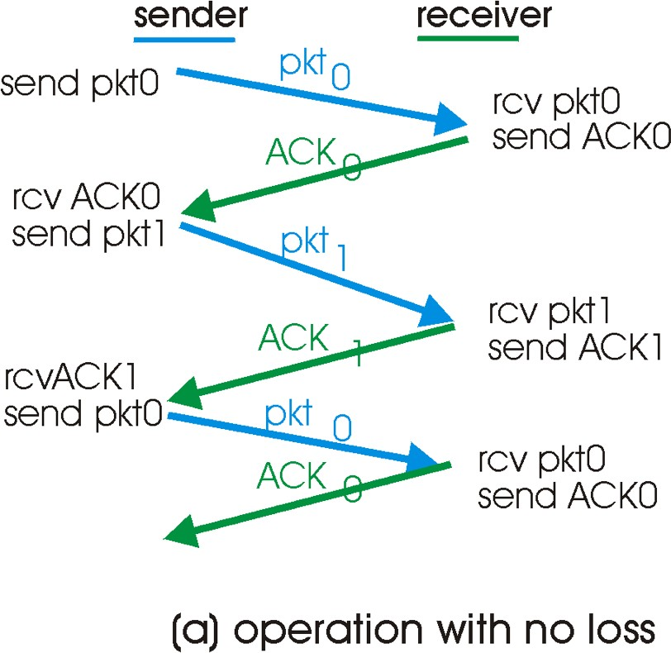
rdt3.0 in action

Slide 61
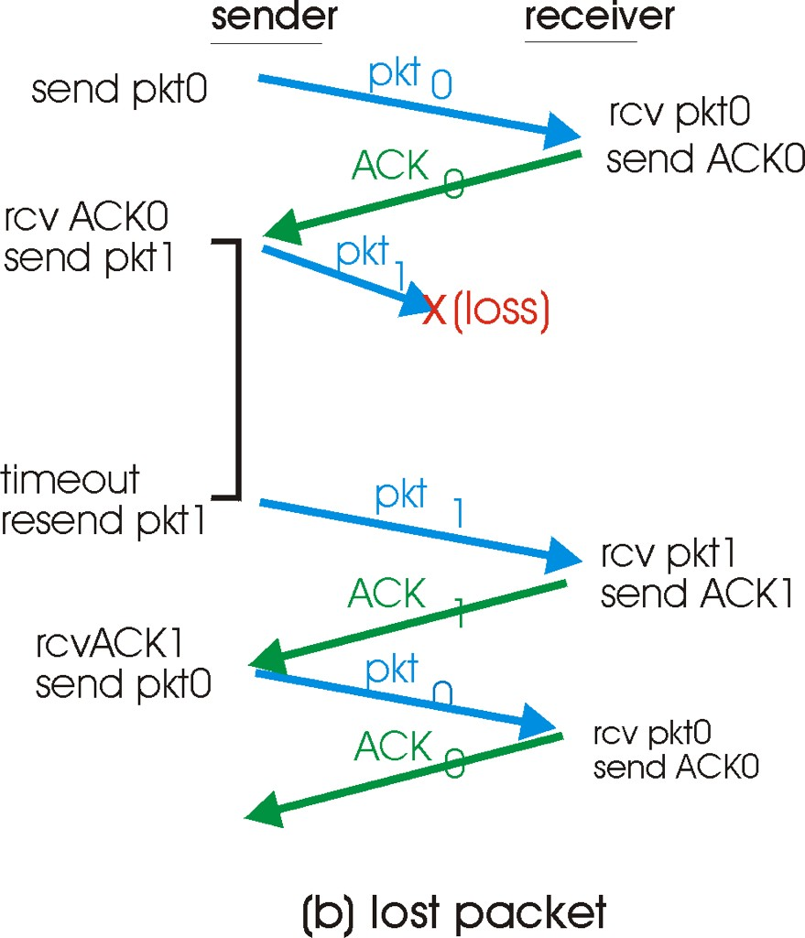
rdt3.0 in action

Slide 62
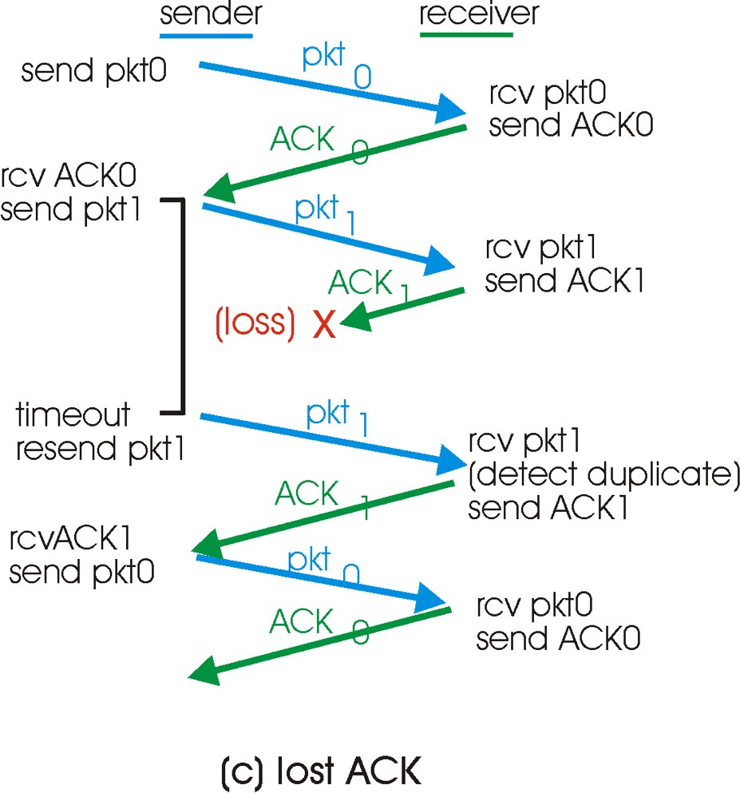
rdt3.0 in action

Slide 63
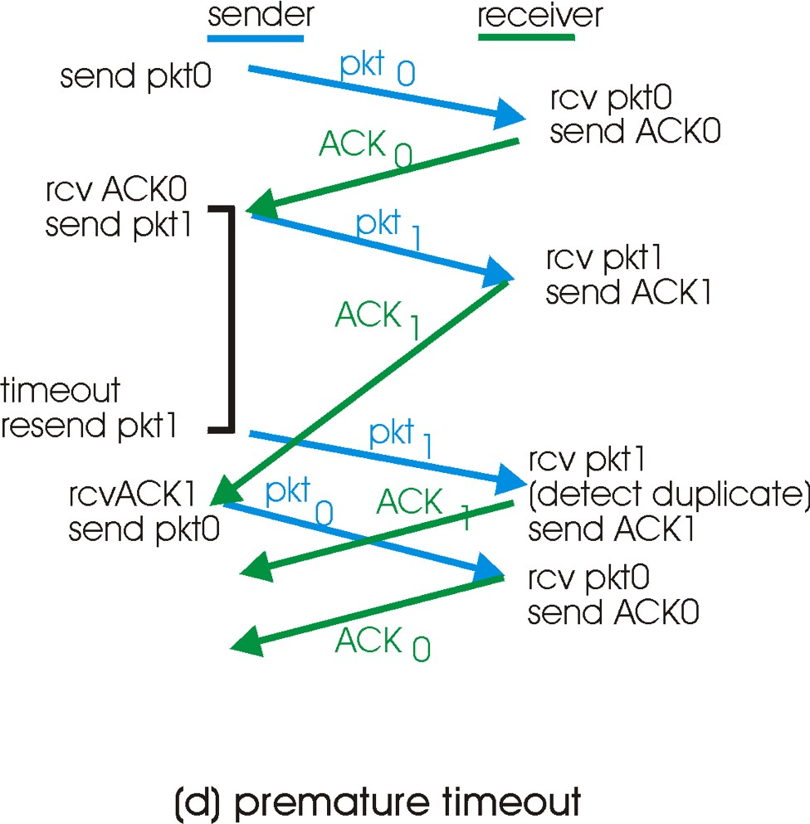
rdt3.0 in action

Slide 64
Performance of rdt3.0

Slide 65
Performance of rdt3.0
rdt3.0 works, but performance stinks

Slide 66
Performance of rdt3.0
rdt3.0 works, but performance stinks
ex: 1 Gbps link, 15 ms prop. delay, 8000 bit packet:

Slide 67


Performance of rdt3.0
rdt3.0 works, but performance stinks
ex: 1 Gbps link, 15 ms prop. delay, 8000 bit packet:

Slide 68
Performance of rdt3.0
rdt3.0 works, but performance stinks
ex: 1 Gbps link, 15 ms prop. delay, 8000 bit packet:
 U _{sender}: utilization – fraction of time sender busy sending

Slide 69

Performance of rdt3.0
rdt3.0 works, but performance stinks
ex: 1 Gbps link, 15 ms prop. delay, 8000 bit packet:
 U _{sender}: utilization – fraction of time sender busy sending

Slide 70
Performance of rdt3.0
rdt3.0 works, but performance stinks
ex: 1 Gbps link, 15 ms prop. delay, 8000 bit packet:
 U _{sender}: utilization – fraction of time sender busy sending
 if RTT=30 msec, 1KB pkt every 30 msec -> 33kB/sec thruput over 1 Gbps link

Slide 71
Performance of rdt3.0
rdt3.0 works, but performance stinks
ex: 1 Gbps link, 15 ms prop. delay, 8000 bit packet:
 U _{sender}: utilization – fraction of time sender busy sending
if RTT=30 msec, 1KB pkt every 30 msec -> 33kB/sec thruput over 1 Gbps link
Protocol limits use of physical resources.

Slide 72

rdt3.0: stop-and-wait operation
sender
receiver
first packet bit transmitted, t = 0 last packet bit transmitted, t = L / R
first packet bit arrives
last packet bit arrives, send ACK
RTT
ACK arrives, send next
packet, t = RTT + L / R

Slide 73
rdt3.0: stop-and-wait

Slide 74
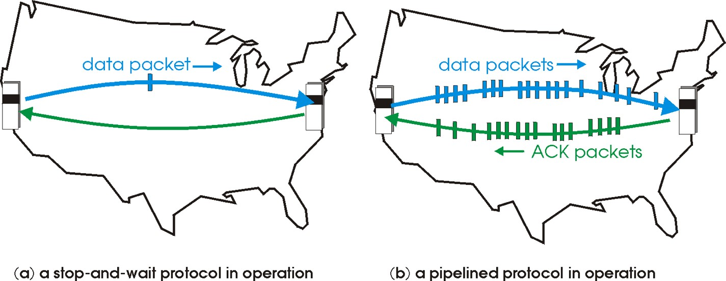
Pipelined protocols
pipelining: sender allows multiple, “in-flight”, yet-to- be-acknowledged pkts
range of sequence numbers must be increased
buffering at sender and/or receiver
 two generic forms of pipelined protocols: go-Back-N, selective repeat

Slide 75






Pipelining: increased utilization
sender receiver
first packet bit transmitted, t = 0 last bit transmitted, t = L / R
first packet bit arrives
last packet bit arrives, send ACK
last bit of 2nd packet arrives, send ACK last bit of 3rd packet arrives, send ACK
RTT
ACK arrives, send next
packet, t = RTT + L / R
Increase utilization by a factor of 3!

Slide 76
Pipelined Protocols

Slide 77
Pipelined Protocols
Go-back-N: big picture:
sender can have up to N unacked packets in pipeline
rcvr only sends cumulative acks
doesn’t ack packet if there’s a gap
sender has timer for oldest unacked packet
if timer expires, retransmit all unack’ed packets

Slide 78
Pipelined Protocols
Go-back-N: big picture:
sender can have up to N unacked packets in pipeline
rcvr only sends cumulative acks
doesn’t ack packet if there’s a gap
sender has timer for oldest unacked packet
if timer expires, retransmit all unack’ed packets
Selective Repeat: big pic
sender can have up to N unack’ed packets in pipeline
rcvr sends individual ack for each packet
sender maintains timer for each unacked packet
 when timer expires, retransmit only unack’ed packet

Slide 79
Go-Back-N
Sender:
k-bit seq # in pkt header
ACK(n): ACKs all pkts up to, including seq # n - “cumulative ACK”
 may receive duplicate ACKs (see receiver)
timer for oldest in-flight pkt
timeout(n): retransmit pkt n and all higher seq # pkts in window

Slide 80
GBN: receiver

Slide 81
GBN: receiver
ACK-only: always send ACK for correctly-received pkt with highest in-order seq #
may generate duplicate ACKs
need only remember expectedseqnum

Slide 82
GBN: receiver
ACK-only: always send ACK for correctly-received pkt with highest in-order seq #
may generate duplicate ACKs
need only remember expectedseqnum
out-of-order pkt:
discard (don’t buffer) -> no receiver buffering!
Re-ACK pkt with highest in-order seq #

Slide 83
Selective Repeat
receiver individually acknowledges all correctly received pkts
buffers pkts, as needed, for eventual in-order delivery to upper layer
sender only resends pkts for which ACK not received
sender timer for each unACKed pkt
sender window
N consecutive seq #’s
again limits seq #s of sent, unACK’ed pkts

Slide 84
Selective repeat
sender
receiver
data from above :
if next available seq # in window, send pkt
timeout(n):
resend pkt n, restart timer
ACK(n) in [sendbase,sendbase+N]:
mark pkt n as received
if n smallest unACKed pkt, advance window base to next unACKed seq #
pkt n in [rcvbase, rcvbase+N-1]
send ACK(n)
out-of-order: buffer
in-order: deliver (also deliver buffered, in-order pkts), advance window to next not- yet-received pkt
pkt n in [rcvbase-N,rcvbase-1]
ACK(n)
otherwise:
ignore

Slide 85
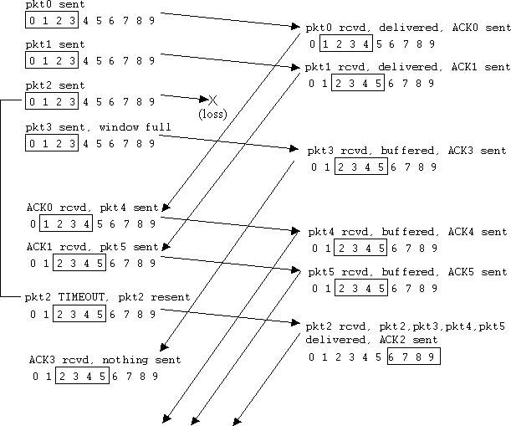
Selective repeat in action
Tran
sport Layer
3-

Slide 86
Selective repeat in action
Tran
sport Layer ³⁻

Slide 87
Selective repeat in action
Tran
sport Layer ³⁻

Slide 88
Selective repeat in action
Tran
sport Layer

Slide 89
Selective repeat in action
Tran
sport Layer

Slide 90
Selective repeat in action
Tran
sport Layer

Slide 91
Selective repeat in action
Tran
sport Layer

Slide 92
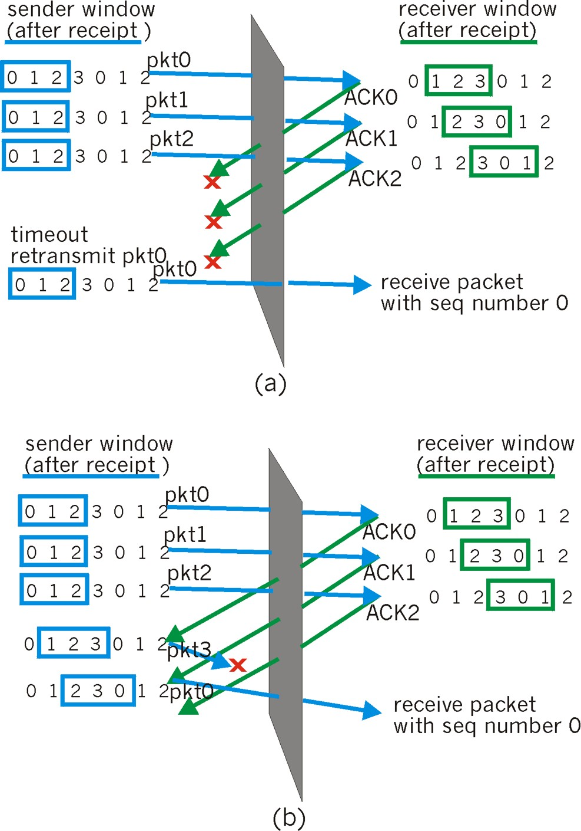
Selective repeat:
dilemma
Example:
seq #’s: 0, 1, 2, 3
window size=3
Transport Layer ³⁻

Slide 93
Selective repeat:
dilemma
Example:
seq #’s: 0, 1, 2, 3
window size=3
Transport Layer ³⁻

Slide 94
Selective repeat:
dilemma
Example:
seq #’s: 0, 1, 2, 3
window size=3

Slide 95
Selective repeat:
dilemma
Example:
seq #’s: 0, 1, 2, 3
window size=3
receiver sees no difference in two scenarios!
incorrectly passes duplicate data as new in (a)

Slide 96
Selective repeat:
dilemma
Example:
seq #’s: 0, 1, 2, 3
window size=3
receiver sees no difference in two scenarios!
incorrectly passes duplicate data as new in (a)
Q: what relationship between seq # size and window size?

Slide 97
Reliability Concepts
Checksums
Sequence numbers
Acknowledgments
Negative ACKs
Window + pipelining
Timers

